Slide 1
A DataVerse Beyond The Internet
Jorrit Poelen https://jhpoelen.nl

Slide 2
Guiding Questions
How do you cite data?
How do you look up cited data now?
How do you look up cited data 40 years from now?

Slide 3

There’s A Kitty In The DataVerse…
Harvard Kitty

Slide 4
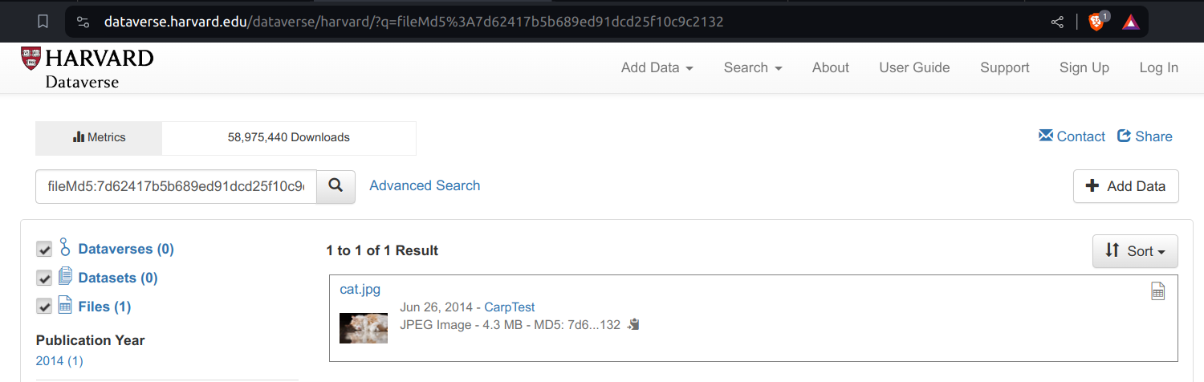
There’s A Kitty In The DataVerse…
Harvard Kitty Internet Page

Slide 5
So How’d You Cite This Kitty Picture?
Joshua Carp, 2014, “cat.jpg”, CarpTest, https://doi.org/10.7910/DVN/24358/N4FCVS, Harvard Dataverse, V1 ¹

Slide 6
How To Retrieve This Kitty Picture Now?
Like this?
curl -L "https://doi.org/10.7910/DVN/24358/N4FCVS"\ > cat.jpg

Slide 7
How To Retrieve This Kitty Picture Now?
Wait a minute …
cat cat.jpg | head -n2
<?xml version='1.0' encoding='UTF-8' ?> <!DOCTYPE html>
That ain’t no cat, it is an HTML page.

Slide 8
How To Retrieve This Cat Picture Now?
Take 2.
turn on the internet (still there?)
open a web browser
load https://doi.org/10.7910/DVN/24358/N4FCVS
and rely on a delicate and complex socio-technical network
inspect page
use mouse to click on a link that looks like cat.jpg
download image and trust its authenticity

Slide 9
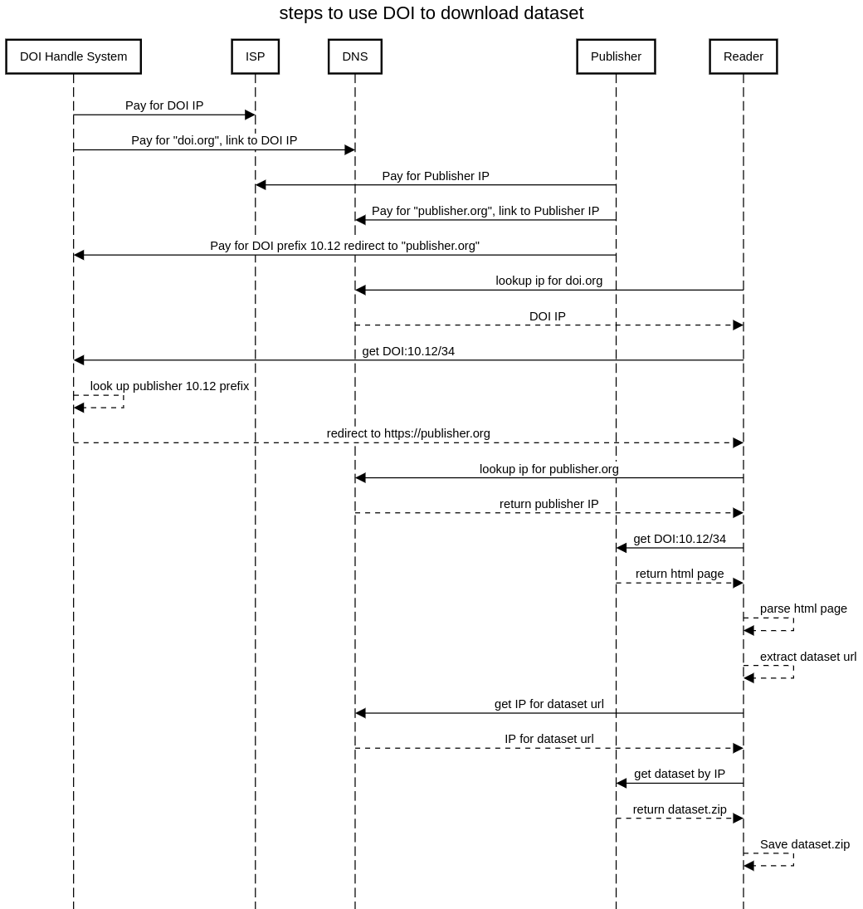
DOI Economics and Redirection
DOI Redirection Sequence Diagram

Slide 10
How To Retrieve This Cat Picture 50 Years From Now?
Joshua Carp, 2014, “cat.jpg”, CarpTest, https://doi.org/10.7910/DVN/24358/N4FCVS, Harvard Dataverse, V1
Likely will not work due to intricate network of dependencies.

Slide 11
How To Retrieve This Cat Picture 50 Years From Now?
Proposal: Sign the citation ²
… by adding the digital fingerprint of the image.
Joshua Carp, 2014, “cat.jpg”, CarpTest, https://doi.org/10.7910/DVN/24358/N4FCVS, Harvard Dataverse, V1 hash://md5/7d62417b5b689ed91dcd25f10c9c2132

Slide 12
How To Retrieve This Cat Picture 50 Years From Now?
… by searching the world (in, and beyond, the internet) for the content with the unique fingerprint hash://md5/7d62417b5b689ed91dcd25f10c9c2132 .
https://linker.bio/hash://md5/7d62417b5b689ed91dcd25f10c9c2132
https://dataverse.harvard.edu/dataverse/harvard/?q=fileMd5%3A7d62417b5b689ed91dcd25f10c9c2132
preston cat --remote https://dataverse.harvard.edu hash://md5/7d62417b5b689ed91dcd25f10c9c2132
preston cat --remote https://dataverse.org hash://md5/7d62417b5b689ed91dcd25f10c9c2132
preston cat --remote https://linker.bio,https://databverse.org hash://md5/7d62417b5b689ed91dcd25f10c9c2132

Slide 13
Internet Is Designed For Exchanging Information
The internet is a powerful tool for exchanging digital information. But the Internet’s contents changes constantly: websites are launched and taken down, webpages change, and content gets archived or lost.³

Slide 14
Internet Is Location-based
By design, a web address, or Uniform Resource Locator (URL), points to a specific internet location from which a resource, like a webpage, can be retrieved. However, a URL does not provide a way to verify that a retrieved webpage was the one we asked for. ⁴

Slide 15
Finding Content By Their Location Is … Tricky
Imagine using a URL-like reference to find a book at a library: instead of locating a book by what it is (e.g., title, author), you refer to a book by its location (e.g., third shelf on the second row next to the window). With this, a book becomes unfindable if moved to another shelf. And, if you do manage to find a book at the referenced location, how would you know you’ve found the book you are looking for? ⁵

Slide 16
Finding Content By Their (Summarized) Content Is … What Librarians Do
Instead of pointing to where books are located, librarians point to them using a bibliographic reference. For practical reasons, only a few identifying clues are included in such a reference (e.g., author, year of publication, title, and publisher). So, librarians refer to content by what it is, and knowing where it may be located is secondary. ⁶
A bibliographic citation:
Darwin, C. 1859. On the Origin of Species. John Murray.

Slide 17
Turns out that there are cats in the DataVerse too . . .
preston cat\ --remote "https://dataverse.org"\ hash://md5/7d62417b5b689ed91dcd25f10c9c2132\ > cat.jpg
Harvard Kitty

Slide 18
Notes
1. As suggested in https://dataverse.harvard.edu/file.xhtml?persistentId=doi:10.7910/DVN/24358/N4FCVS accessed on 2024-02-06 https://dataverse.org/best-practices/data-citation
2. Elliott M.J., Poelen, J.H. & Fortes, J.A.B. (2023) Signing data citations enables data verification and citation persistence. Sci Data. https://doi.org/10.1038/s41597-023-02230-y hash://sha256/f849c870565f608899f183ca261365dce9c9f1c5441b1c779e0db49df9c2a19d
3. Jorrit Poelen. 2024. Unleashing Digital Knowledge Into The Future. Accessed on 2024-02-06 at https://linker.bio line:hash://sha256/8ac18eb75ff20d40d1d60bb6ad5a745eb528093d1ffbe373e3847c13146091eb!/L12
4. Jorrit Poelen. 2024. Unleashing Digital Knowledge Into The Future. Accessed on 2024-02-06 at https://linker.bio line:hash://sha256/8ac18eb75ff20d40d1d60bb6ad5a745eb528093d1ffbe373e3847c13146091eb!/L14
5. Jorrit Poelen. 2024. Unleashing Digital Knowledge Into The Future. Accessed on 2024-02-06 at https://linker.bio line:hash://sha256/8ac18eb75ff20d40d1d60bb6ad5a745eb528093d1ffbe373e3847c13146091eb!/L16
6. Jorrit Poelen. 2024. Unleashing Digital Knowledge Into The Future. Accessed on 2024-02-06 at https://linker.bio line:hash://sha256/8ac18eb75ff20d40d1d60bb6ad5a745eb528093d1ffbe373e3847c13146091eb!/L18

